Slide 1
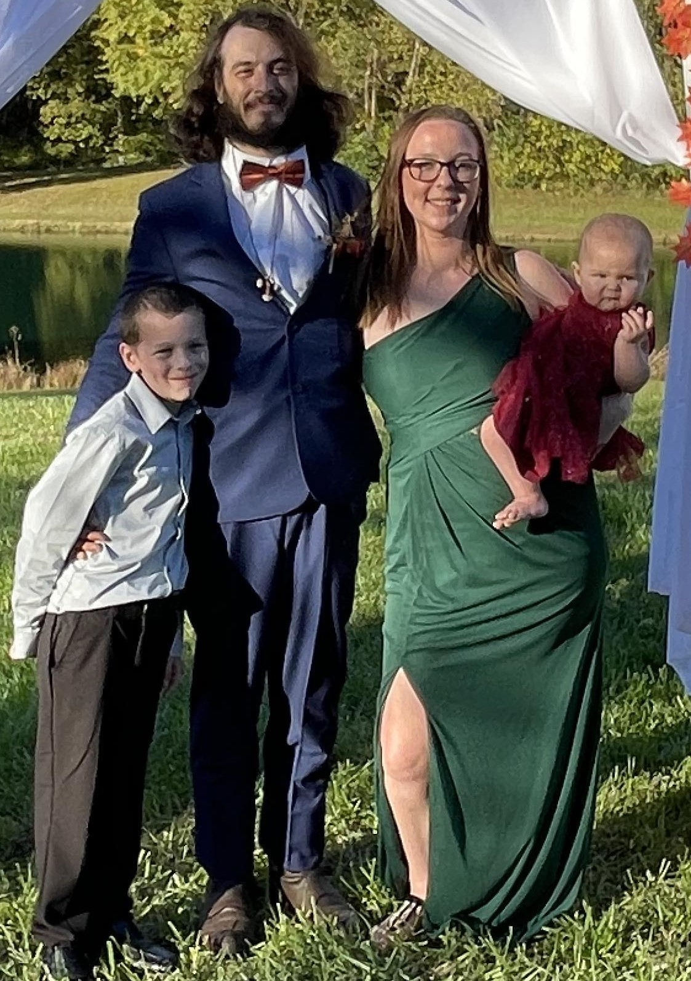




Home Parents page Lucas’ Page Octavia’s page
The Fonnegra Family

Slide 2
Contact Page
Questions or Comments Form
Enter Your Name:
Questions and Comments:
Submit Reset.

Slide 3
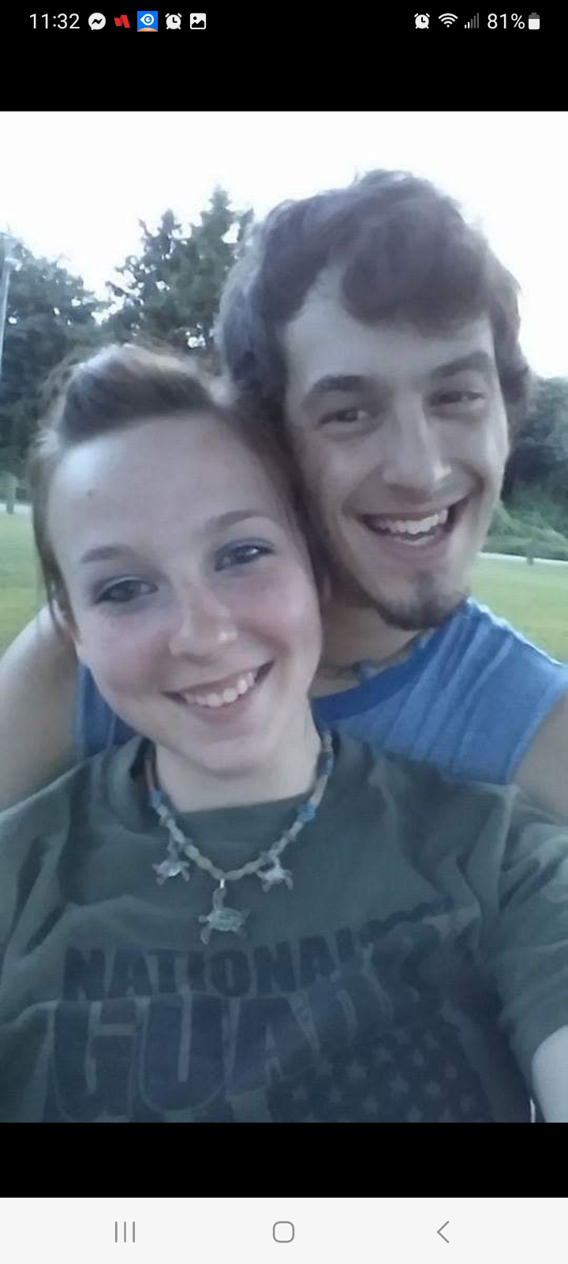
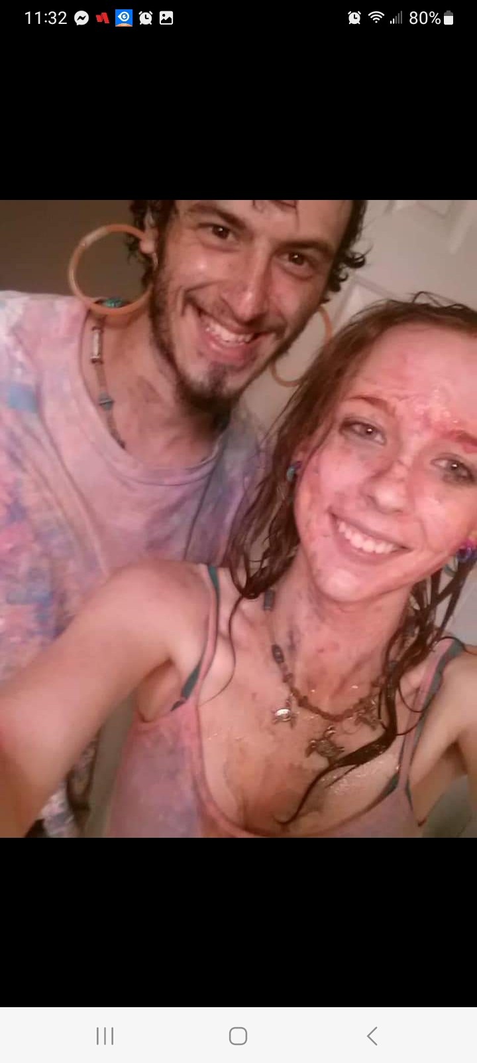
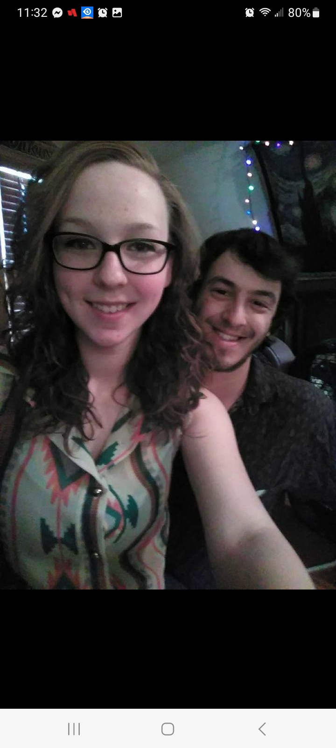
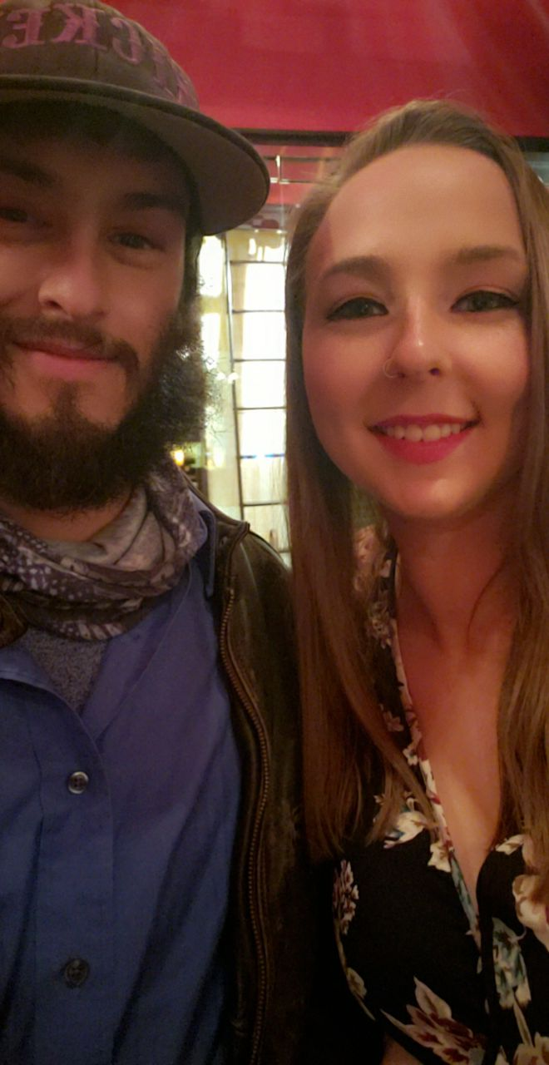
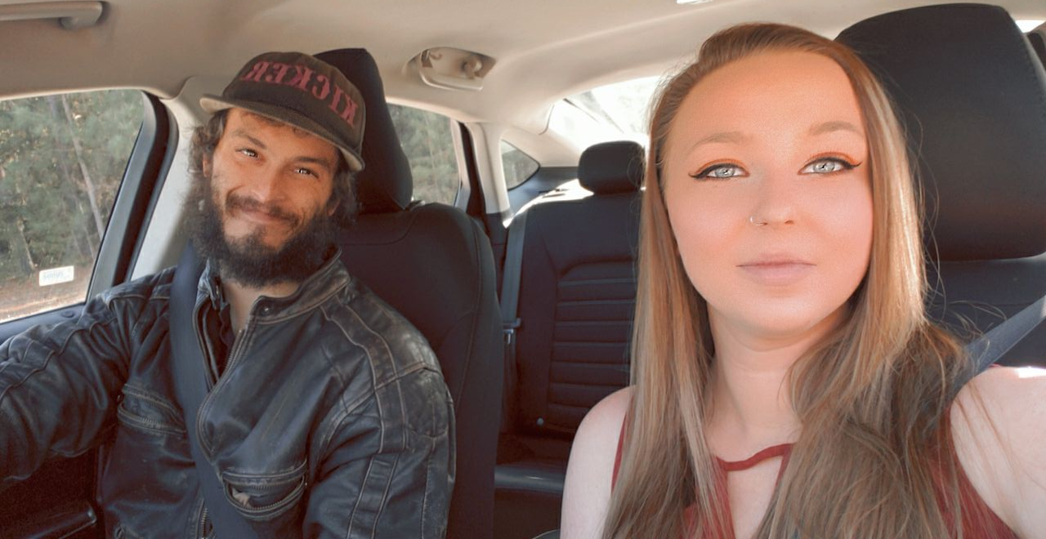
About the parents
Morgan and Adrian met almost 10 years ago. We were together for two years before introducing our wonderful son Lucas into the world and nine years before introducing our daughter.
With all our memories together. The memories we love the most is having our two amazing children. They both have been the best thing that has ever happened to us.

Slide 4
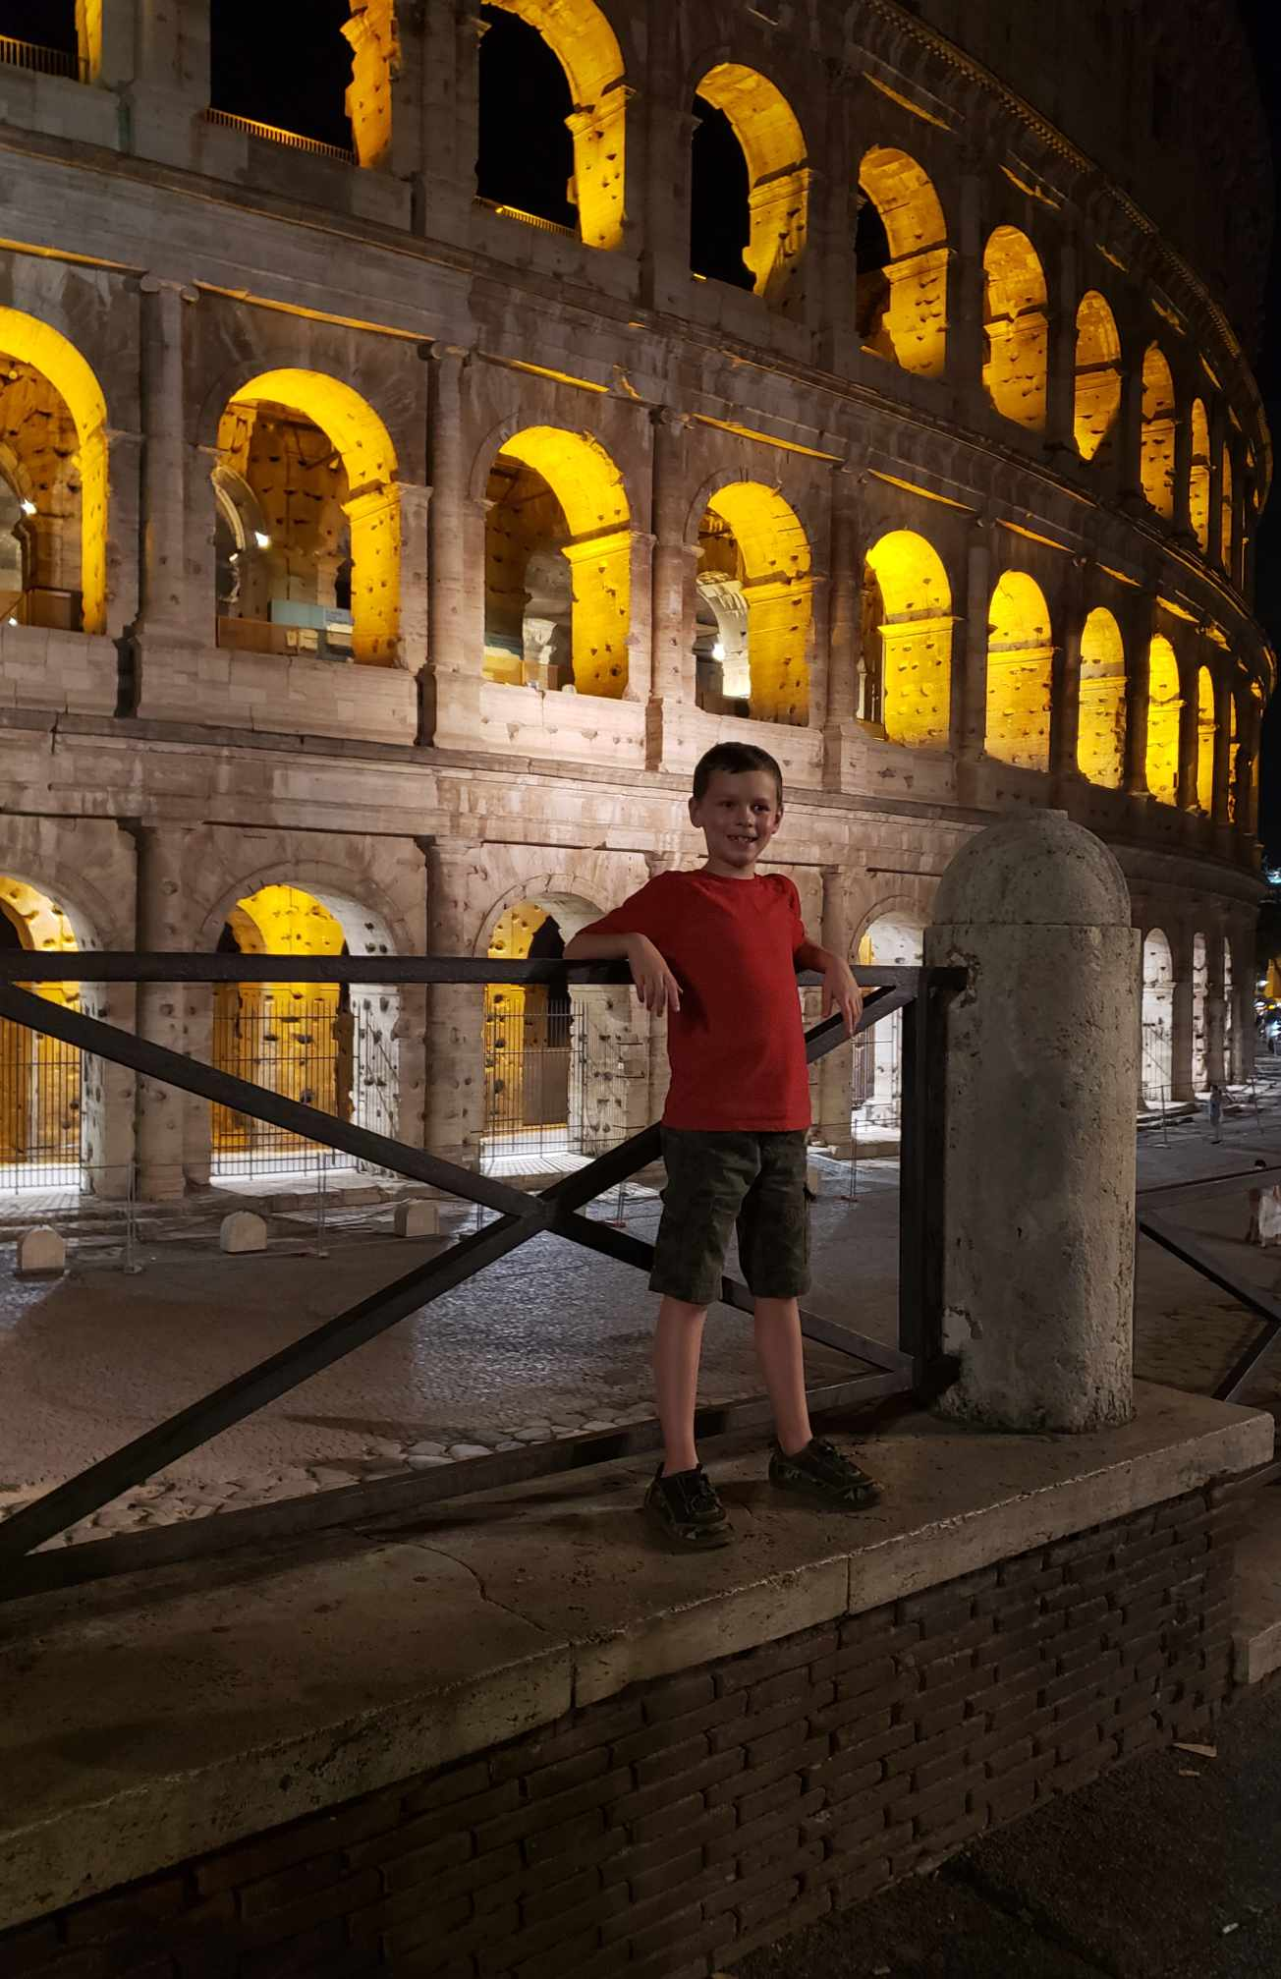
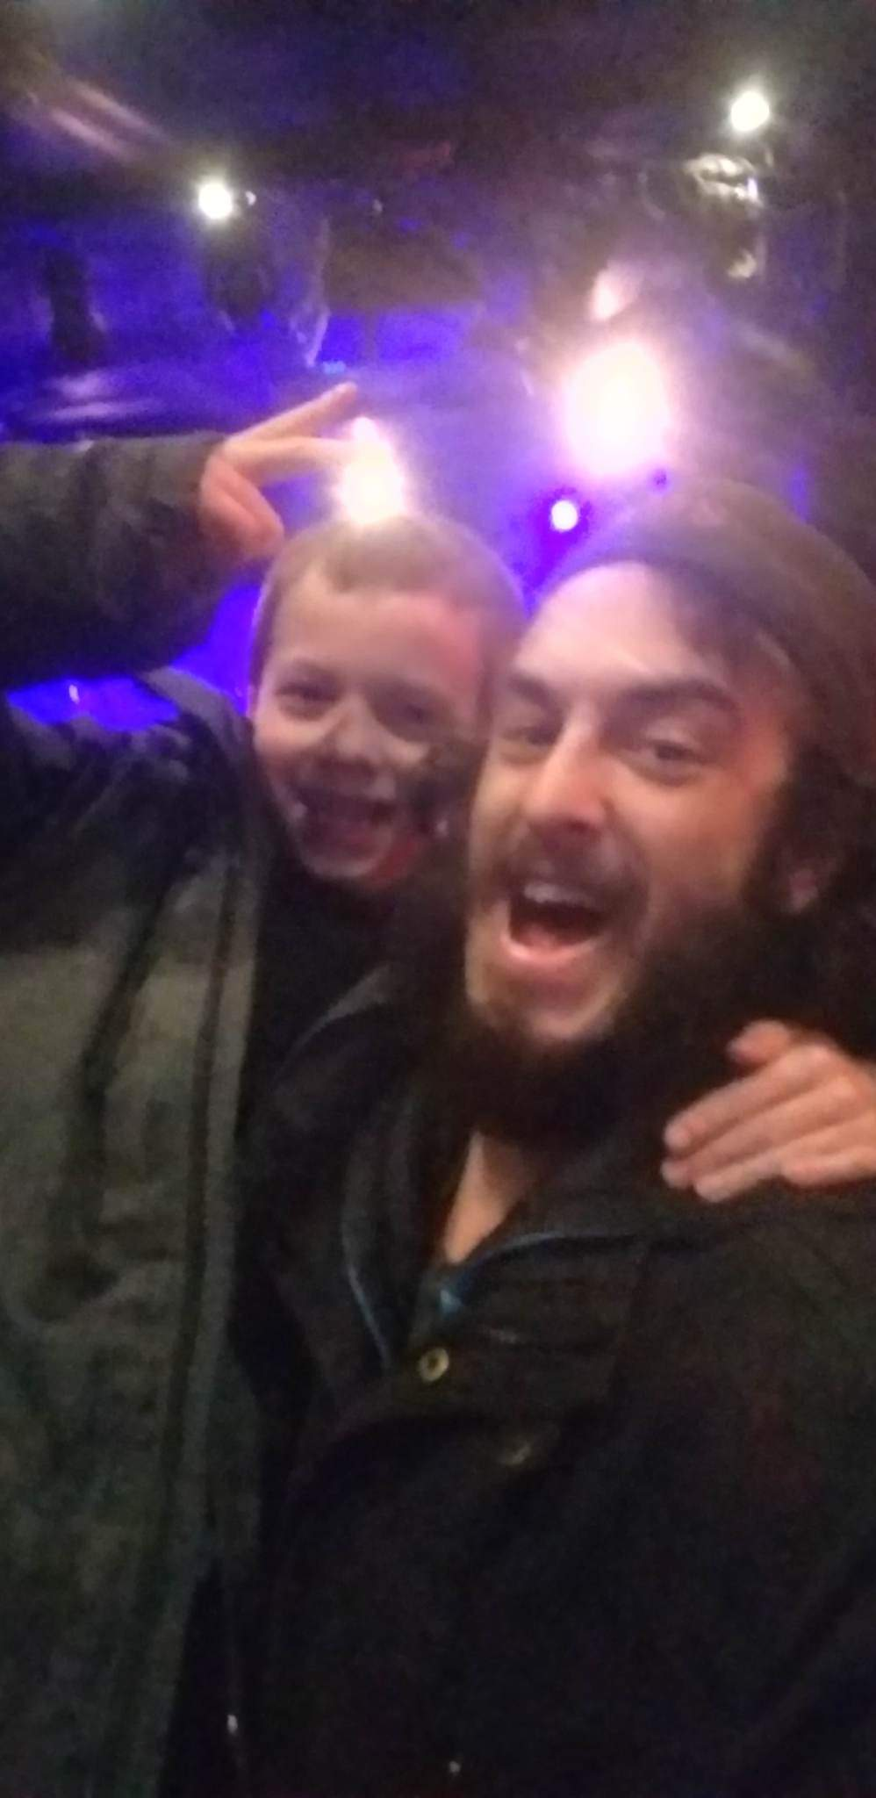
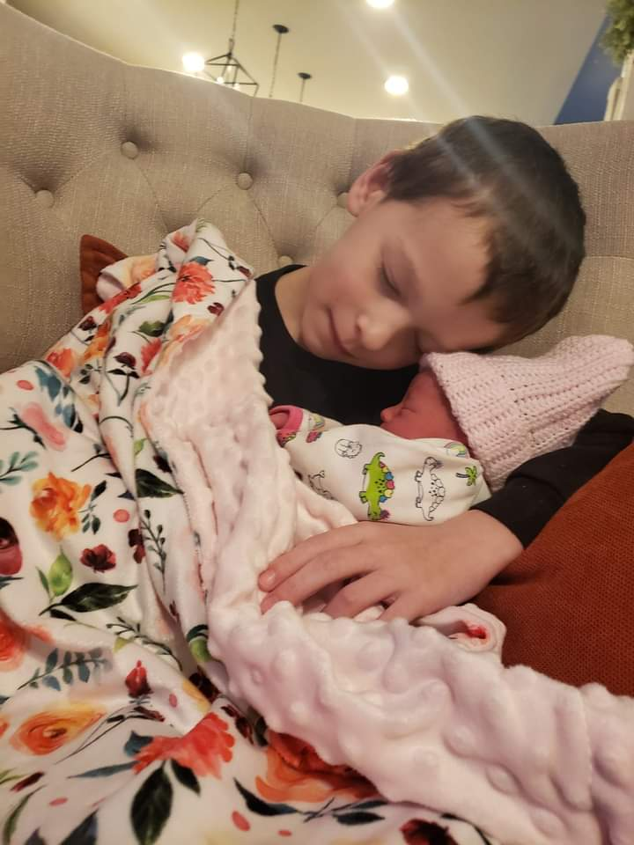
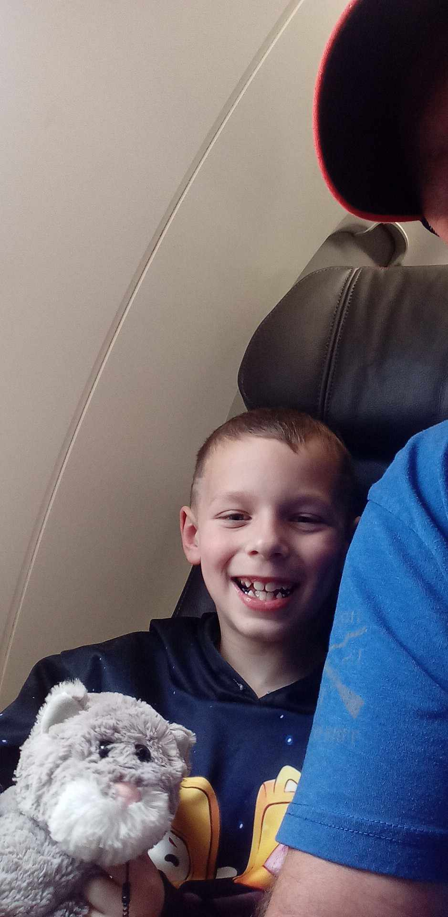
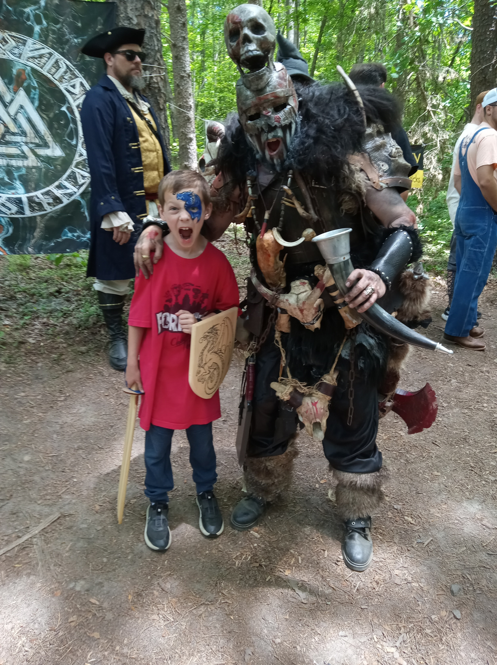
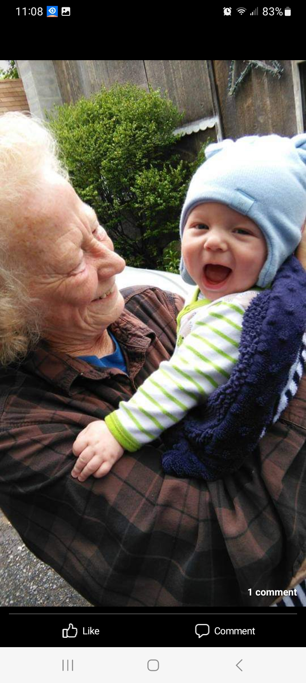
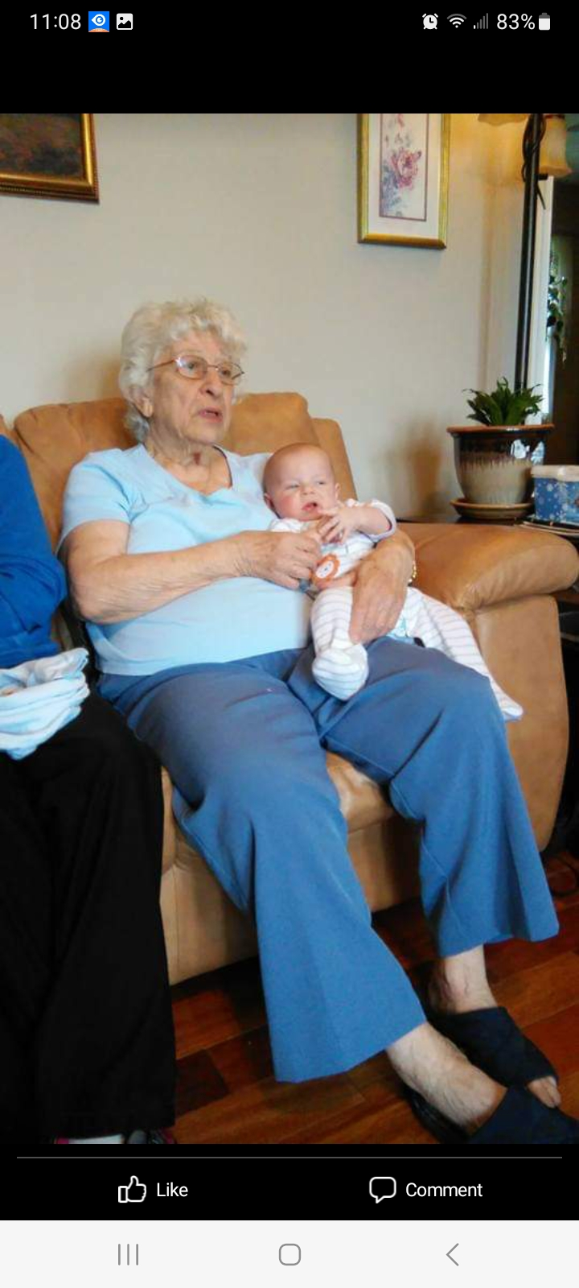
Lucas’ Page
Lucas entered our family on December 11. He was the first grandchild on his mom’s side and spoiled more than you could possibly imagine. He was the one of the best gifts life could hive us and loved everything. We learned a lot about Lucas during the first year, he loved music. He was a fan of AC?DC He loved looking at everyone he met. And was the best baby since the day he was born. He is now almost 8 years old!
This picture was the first time Lucas met his great grandmother Judy. She lived in Maryland, and we did not get the chance to go up there often, but he got to visit her again in March of 2022, which is perfect, since great grandma Judy ended up passing away in November of 2023.
This is not the only great grandmother he got to meet! He met his great grandma Clara, we even got to take a five-generation picture. Sadly, great grandma Clara passed away in November of 2019.
After years of Lucas being the only child and having all our attention. We welcomed his sister into our family. Lucas was so excited to meet his sister. They have the sweetest relationship, and we love to watch it grow. He is a wonderful big brother and is a great helper for mom and dad.
Since we had Lucas' sister, we made sure Lucas was still getting our attention. Though, having a newborn in the house and being exhausted. So, dad won concert tickets on the radio one morning to see the 502's, which mom said that Lucas and dad would go together and get time to spend with each other.
Along with going to a concert to get our attention after having his sister. He also got to visit Germany since his Nanny and grandfather moved overseas. He got to do a lot of fun things over in Germany.
Lucas got to fly over to Germany with grandpa. They took him to Roma to visit the colosseum!
While visiting Europe, Lucas got to go to Disney in Paris!
Not only did he get to do fun things with his grandparents. But mom and dad made sure we did fun things too! We saw that the renaissance festival came back to Virginia, and we were excited to take him to it! This picture is Lucas posing with a nice person that was there dressed up. He did not work with the people at the renaissance fair. But he looked awesome!
Lucas has had many fun years as the only child and has had a great year of being a big brother. He is the sweetest boy! Mom and dad could not be happier with him!

Slide 5
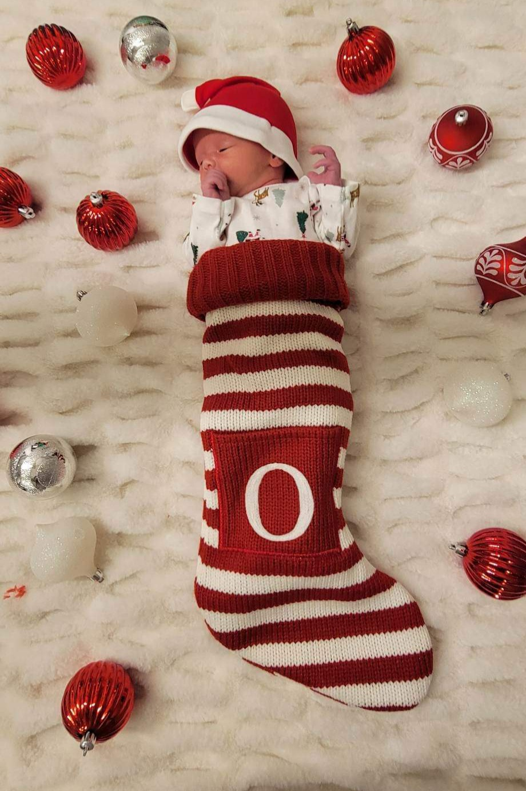
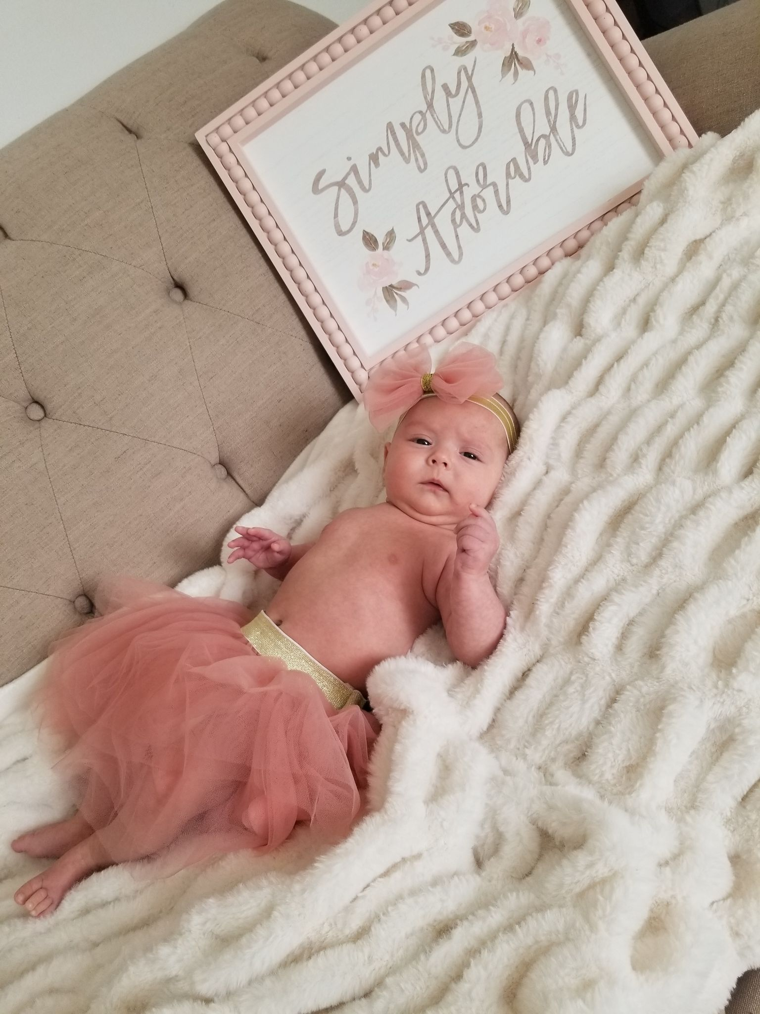
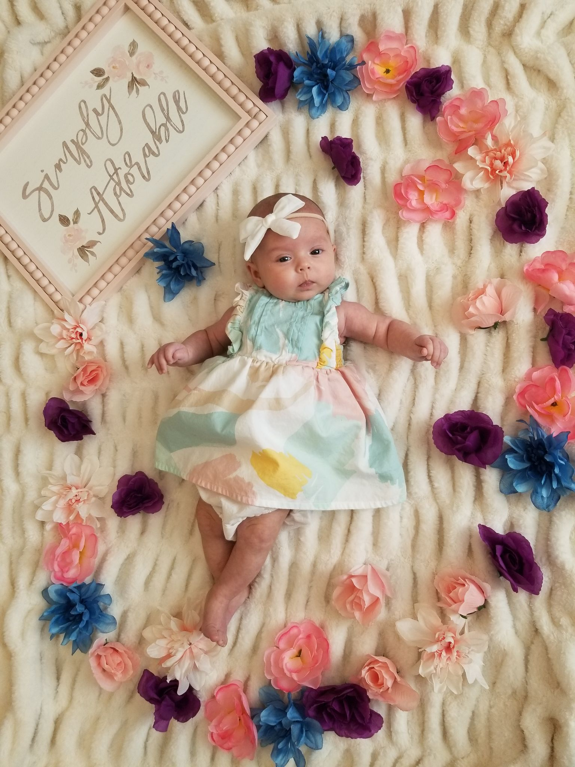
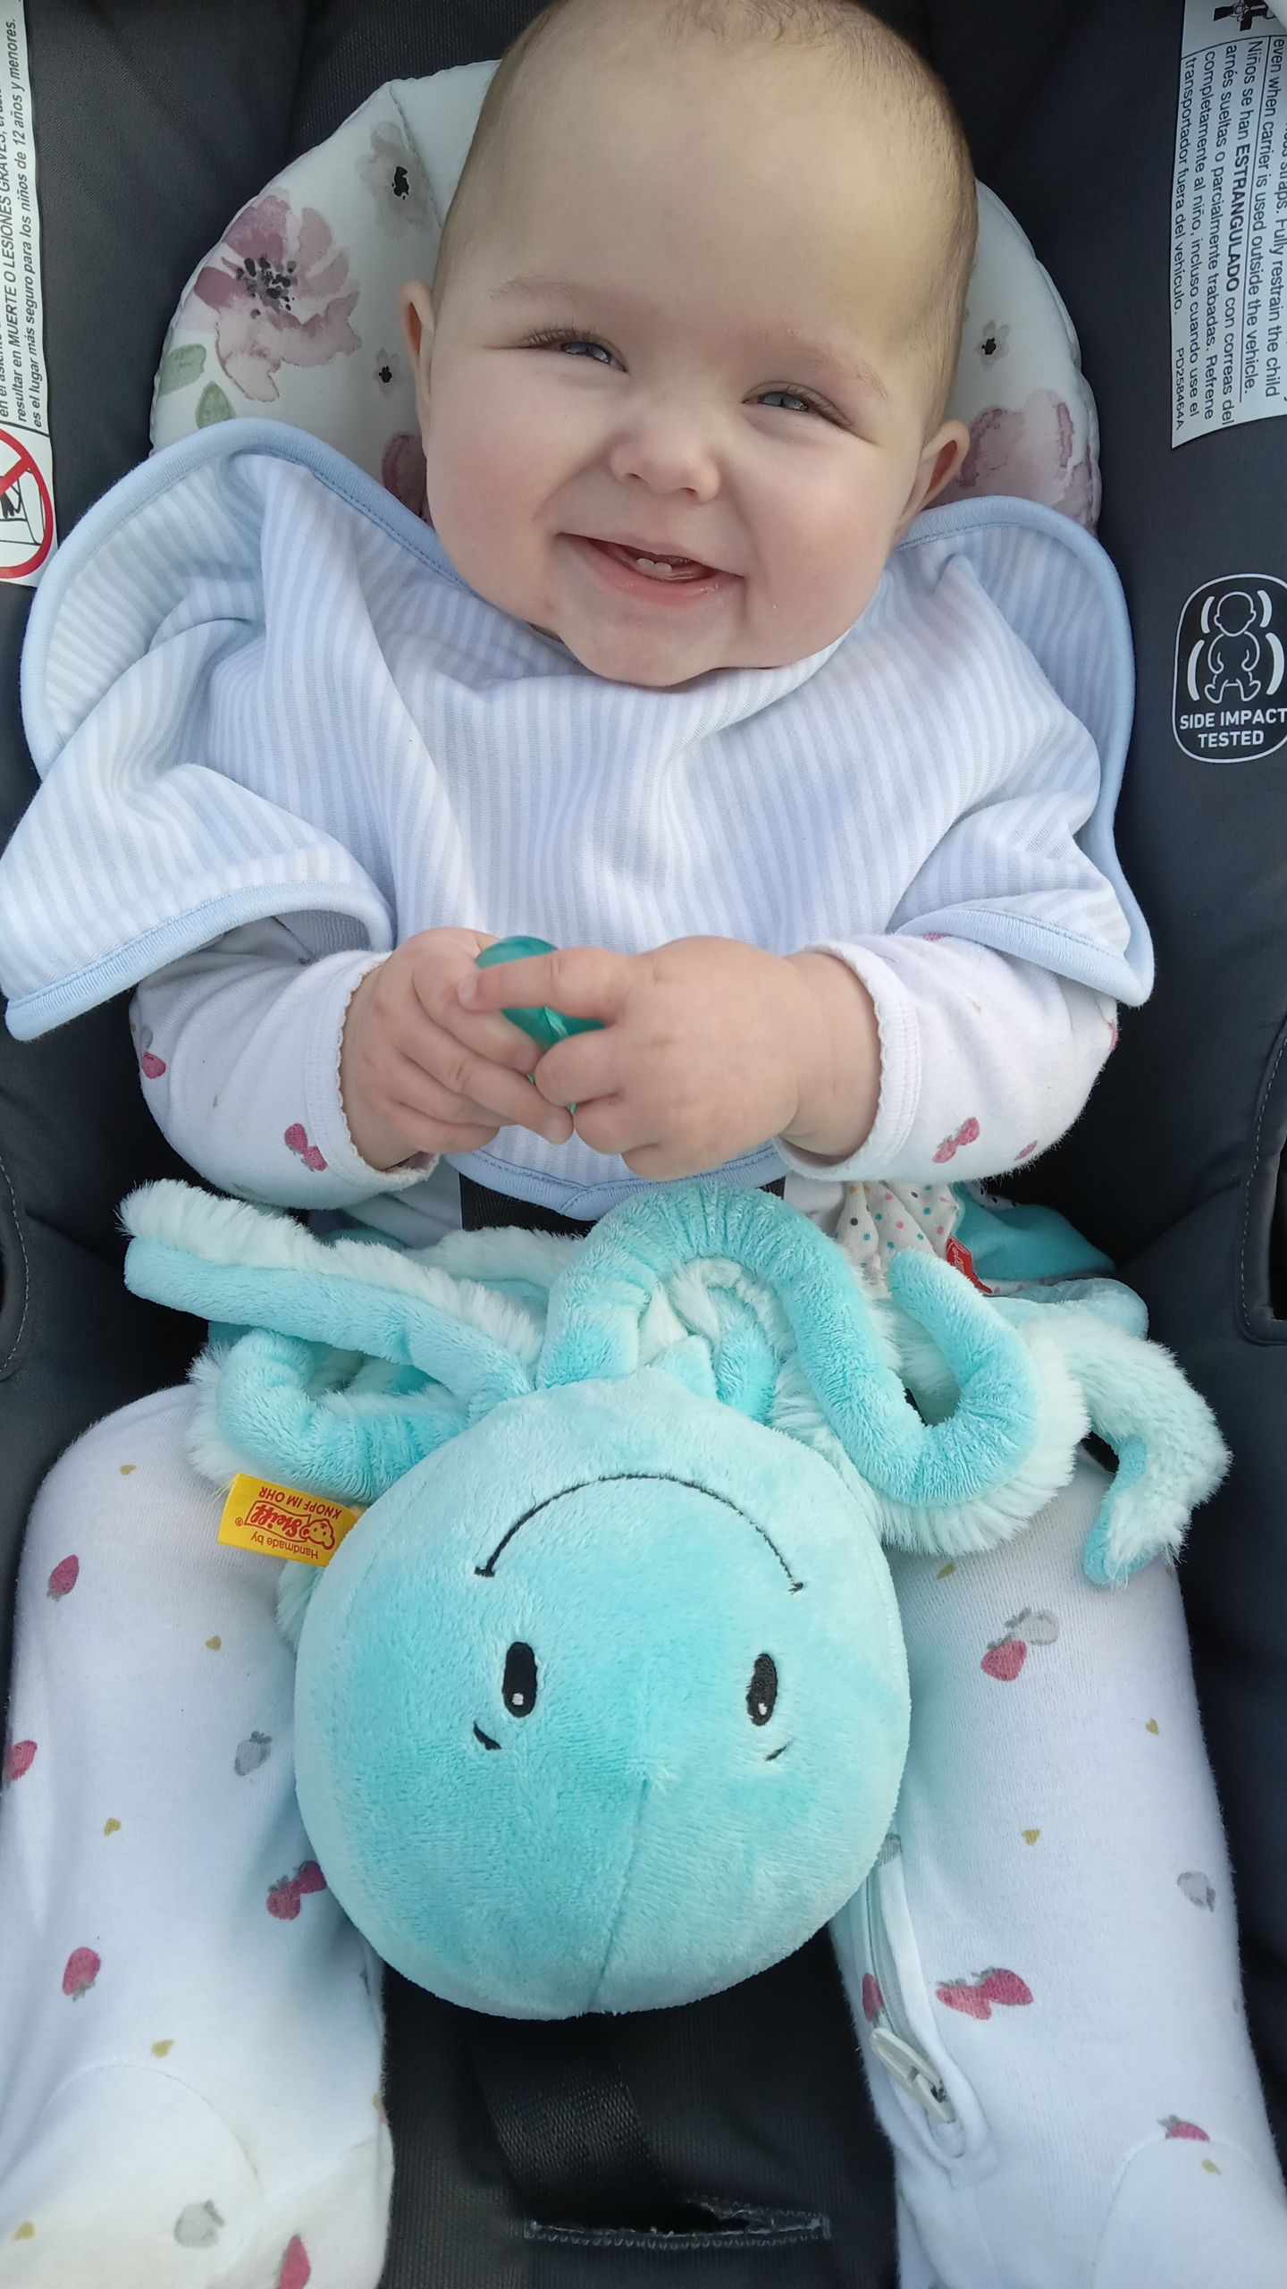
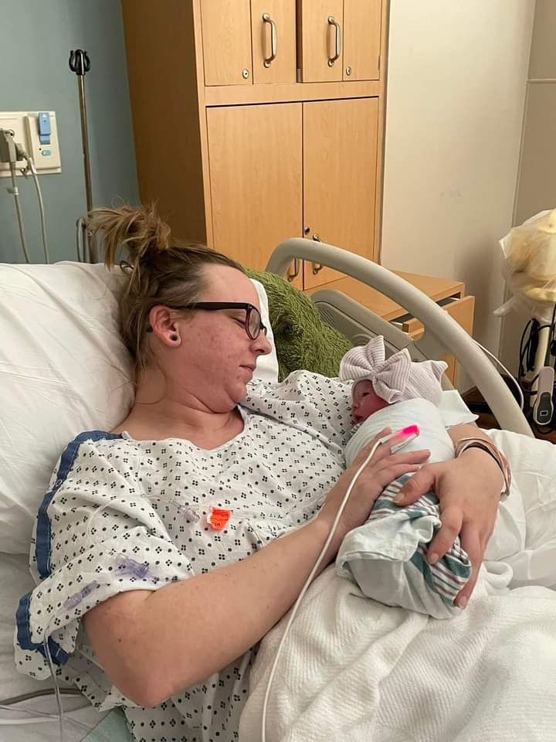
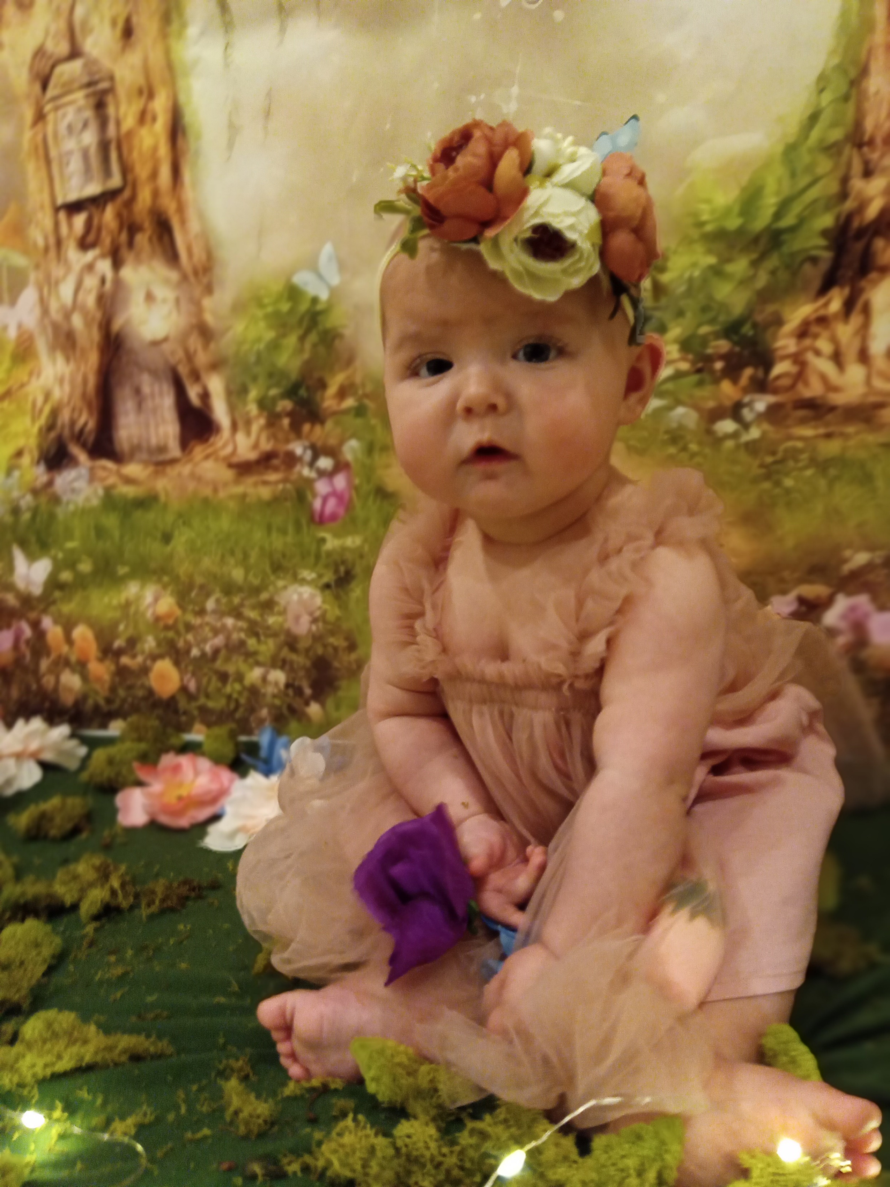
Octavia’s Page
Octavia was a blessing we did not know we needed to complete our little family. She brings us all together. Though, mom had many complications throughout the pregnancy and ended up having to have Octavia earlier than expect, we couldn't be happier. She is defiantly our wild child and not even a year old yet. Octavia was born on December 28th!
Since Octavia was born just three days after Christmas of course we had to do her newborn photos with a Christmas theme.
When Octavia was three months old it was close to Easter. Mom got her a cute easter dress and had flowers around her for this photo shoot. Though, we did some other ones also!
Mom realized how many cute outfits there are for girls rather than boys and thought how it was so unfair though we did milestone photos for Lucas too.
Octavia's six-month photos were mom's favorite. Mom did a fairy theme photo shoot. Octavia made it the hardest photo shoot since we began teething at this age and was not happy. It took mom at least 4 days to finally get a smile from her!
Octavia finally got her two bottom teeth in! I just loved her little teeth smiles! She is such a sweet girl when she wants to be!
Octavia has a lot of personality already. She already has the same attitude as her mom! She is going to be a handful and we look forward to the things she will end up doing. Octavia also has a few nicknames mom has been using like O, or Tavia. She is almost a year old, and we are looking forward to many more years of watching both crazy kids growing up together!

